Slide 1
Chapter 2
Income

Slide 2
What Development Projects Focus On
Concrete outcomes related to poverty, malnutrition, inequality, and health.
Basic physical needs like nutrition, shelter, and clothing
Development of the mind (and of course people’s earnings potential), through education.
The environment, conservation, and sustainable resource use
Human rights, gender and ethnic equity
Government corruption

Slide 3
Income vs. Development
In rich countries: development and income growth are seen as similar
  E.g., think about urban development projects
A lot of things correlate with income
  Life expectancy is higher in the US than Malawi
But most development economists would say development is different from income growth
  …though it’s hard to have development without income growth

Slide 4
Income vs. Development (Don’t confuse these!)
Economic development involves many outcomes:
  Income growth (Chs 2 & 6), poverty (3), inequality (4), human welfare (5)
Big theme of this class:
  Income growth and development are different things
  …but it’s hard to have development without growth
…so let’s start with income

Slide 5
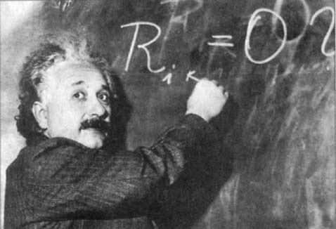
Tools of the Trade:

Slide 6
What is Growth? Income?
Growth: Rise in national or per-capita income and production (Ch. 6)
Gross Domestic Product (GDP; same as National Income)
  Add up value of all final goods and services produced in a country then sold
    Value at market prices
  Alternatively, add up the cost of all factor inputs (Capital, Labor, Land), called Value Added.
    GDP at factor cost

Slide 7
Per-capita Income
Take the GDP
Divide by the population
What everyone would have if income were perfectly equally distributed
One measure of welfare (and development)

Slide 8
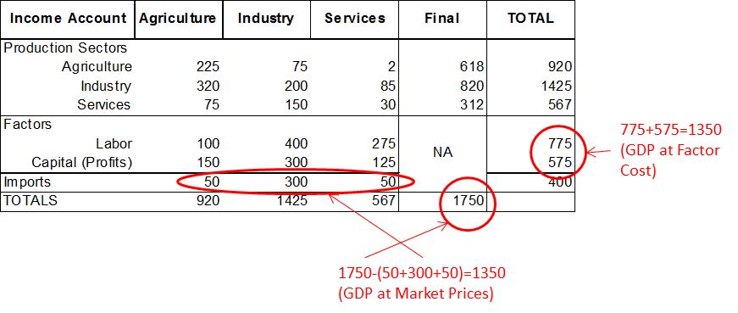
Two Ways to Calculate GDP with Input-Output Accounting

Slide 9
Leontief Multiplier Analysis
To meet a 1-unit increase in food demand in the economy, Agriculture has to produce 1.36 more, Industry 0.58 more, and Services, 0.18 more.

Slide 10
Green Accounting
697.5+517.5=1,215(<1,350)
Standard Accounting

Slide 11
GNP vs. GDP
Gross National Product: Like GDP but includes the value the country’s citizens produce outside the country’s borders
  Philippines: GDP is ~6% lower than GNP, because it doesn’t count income of Philippine migrants working abroad
  If Philippine person works in Malaysia, the value of output she produces counts in the Philippines’ GNP but not its GDP.
    It counts in Malaysia’s GDP but not GNP
We often use GDP; it usually doesn’t matter much

Slide 12
Real vs. Nominal GDP
Real means “adjusted for inflation”
  Very important for comparing a country’s changes in income over time:

Slide 13
Purchasing Power Parity (PPP)
Adjusts exchange rates for purchasing power of income in different countries
  Critical for comparing incomes across countries
    Mexico: Exchange Rate on 1-5-2010 was 12.8 pesos/US$
    But you get more for your money in Mexico (~44% more), so the PPP exchange rate is around 8.9 (=12.8/1.44)
      In other words,12.8 pesos gives you not $1 but $1.44 (=12.8/8.9) in purchasing power in Mexico if you adjust for PPP!
      8.9 pesos give you $1 in purchasing power parity

Slide 14
Making an Income Index
Rank index:
Income index (see index generator program):

Slide 15
Country Typologies
World Bank Standard:
  Low Income (<US$765/capita in 2003)
  Lower Middle ($765-$3,035)
  Upper Middle ($3,035-$9,385)
  High (>$9,385)
Other terms:
  Third World (Pretty much out of use)
  Less Developed, Developing (Commonly heard at international forums)
  Emerging (Rapidly growing: China, E. European)
  Industrialized (What about post-industrial OECD?)
  Transitional (E. Europe, Russia, Ukraine: Controlled market -> market oriented economies)
  North-South (Imprecise, but still heard sometimes)

Slide 16
What’s NOT in GDP?
GDP Excludes intermediate inputs (no double counting)
Includes goods & services produced by citizens abroad (Mexican migrant remittances add ~$25 billion/year to Mexico’s GDP!)
Excludes goods & services not sold
    Get divorced, hire a cook or nanny, and GDP goes up!
    Me and Home Depot = no contractor and lower GDP
What about obesity? The environment?

Slide 17
Why Look Beyond GDP?
Robert Kennedy explained it (a few weeks before he was assassinated in Los Angeles):
www.youtube.com/watch?v=77IdKFqXbUY

Slide 18
Next Three Chapters
In 2010, just under 1.3 billion people—22.4% of the world’s population—lived on less than $1.25 a day (PPP adjusted).
The low-income countries contained 12.5% of the world’s population but controlled less than 1% of its income, while the high income countries had a little over 16% of its population and 72% of its income.
In the poorest 10% of countries, those with GDP per capita less than $1,123, life expectancy averaged 54.4 years (compared to 80 in the richest 10%), and years of schooling averaged 3.2 years (compared to 10.5 years).

